Slide 2
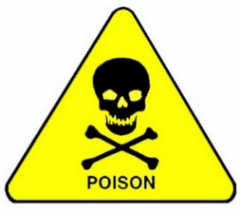
Pesticides (Part I)
Professor
Abeer Abdelwahab Sharaf-Eldin
Professor of Forensic Medicine and Toxicology
Benha Faculty of medicine
2020-2021

Slide 3
Learning objectives
By the end of this presentation, participants should be able to:
Describe the symptoms of patients presenting with pesticides poisoning.
Explain the mechanisms of toxicity for pesticides.
Explain the mechanisms of action for atropine and pralidoxime as antidots.
Recommend a pharmaco-therapeutic regimen for patients presenting with pesticides poisoning.

Slide 4
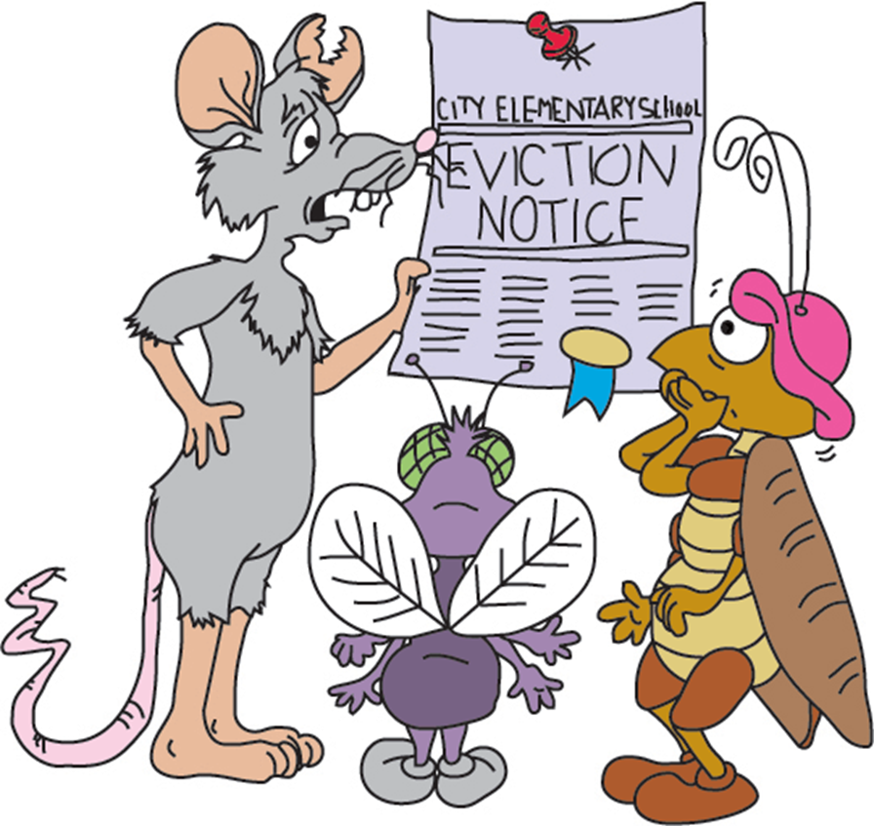
Pesticides is a word that is consisted of 2 parts
Pest : Unwanted living.
Cide: Killing or elimination.

Slide 5
Definition
Pesticides are compounds intended to prevent, destroy or repel any pest (insects- fungi- herbs- rodents- worms).
Generally: Pesticides are chemicals that are used to kill pests.

Slide 6
Classification Insecticides (target insects): e.g. Organophosphates, organonitrogenous (carbamates), organochlorines and pyrethroids. Herbicides (target weeds): e.g. Chlorophenoxy compounds Fungicides (target fungi): e.g. Hexachlorobenzene and Organomercurials. Rodenticides (target rodents): Zinc phosphide, Strychnine

Slide 7
Circumstances of poisoning
1- Accidental poisoning.
General population: through the consumption of foodstuffs treated incorrectly with pesticides or harvested prematurely before residues have declined to acceptable levels or from domestic use.
Among workers during spraying the trees or during manufacture of the compounds.
Among children
2- Suicide attempts: by drinking it as it is easily obtained.
3- Homicidal: by mixing it with foodstuffs.

Slide 8
Routes of administration
Dermal route: via intact skin, this route offers the greatest potential for occupational exposure.
Oral route : it is the most frequent route in case of non-occupational poisoning.
Respiratory route: by inhalation during fumigation of fruit trees.

Slide 9
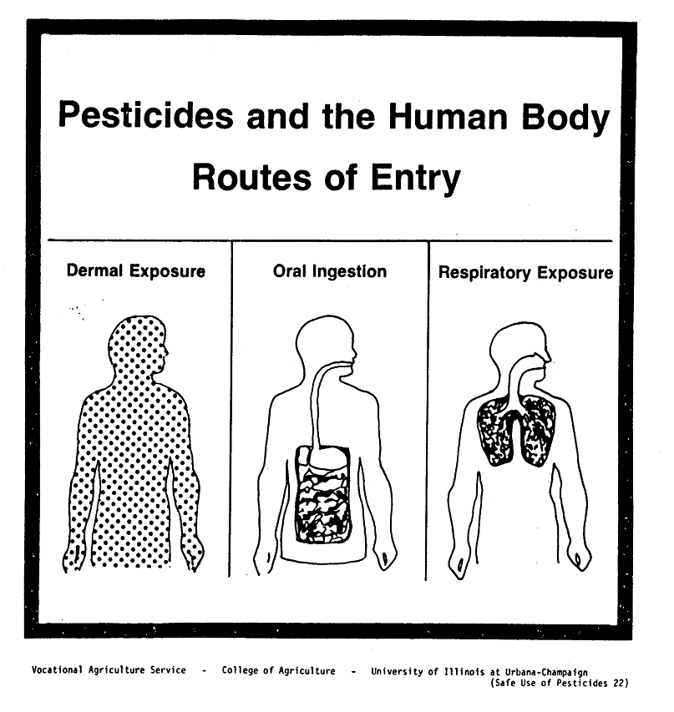

Slide 10
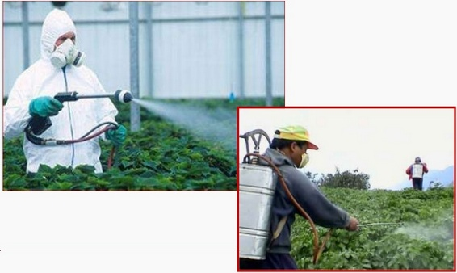

Slide 11
The four major classes of insecticides are
1- Organophosphates.
2-Organonitrogenous (Carbamates).
3- Organochlorines.
4-Pyrethrins and Pyrethroids.

Slide 12
Organophosphate Insecticides
The organophosphates (OPs) are a large group of compounds, with the same basic mechanism of acute toxicity.
They are esters, amides or thiol derivatives of phosphoric, phosphonic, thiophosphoric or thiophosphonic acids.
OPs are used as insecticides in السلم و الحرب
Agricultural and domestic settings.
Nerve agents in warfare and terrorist attacks.

Slide 13
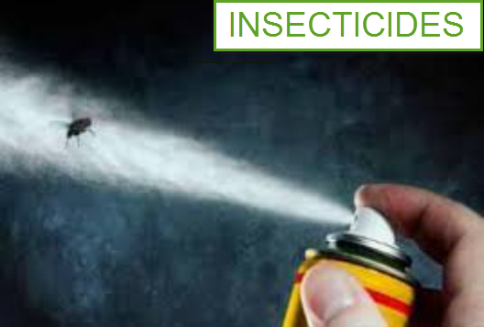

Slide 14
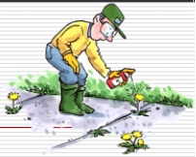
Toxicokinetics
Absorption: occurs via gastrointestinal, dermal, conjunctival and respiratory routes.
Metabolism: occurs in the liver, detoxification occurs via cytochrome P450.
Distribution: most OPs are lipophilic. They distribute into liver, kidney and adipose tissues.
Excretion of metabolites occurs in the urine.

Slide 15
PATHOPHYSIOLOGY
Acetylcholine is a neurotransmitter found at:
1-Some nerve endings within CNS.
2-Skeletal neuromuscular Junction.
3-Both parasympathetic and sympathetic ganglion.
2-Terminal junctions of all postganglionic parasympathetic nerves.
3-Postganglionic sympathetic fibers to most sweat glands.

Slide 16
Under normal circumstances
The vesicles containing ACh rupture to release it and then binds to receptors leading to activation.
Normally, all ACh released by the axons is hydrolyzed immediately by cholinesterases into inactive fragments of choline and acetic acid after neurochemical transmission.

Slide 17
In organophosphates (OPs)
OPs are irreversible anticholinesterase.
The inhibition of the acetylcholinesterase enzyme occurred by phosphorylation, leading to the accumulation of acetylcholine at cholinergic synapses that results in prolonged effect of acetylcholine at a variety of neurotransmitter receptors. producing first stimulatory and then inhibitory effects.

Slide 18
The inactivation of cholinesterase enzymes by OPs occurs in several stages and becomes progressively irreversible after 24 to 36 hours and therefore it is the critical interval during which the antidote can reverse the process. If the antidote is not administered, the OP-AChE bond becomes permanent. This process is known as aging.

Slide 19
In human beings, there are two principal cholinesterases which are:
RBC or true cholinesterase (acetylcholinesterase) which is present in human red blood cells, nervous tissues and skeletal muscles.
Serum or plasma cholinesterase (pseudocholinesterase) which is present in human plasma and in the liver.

Slide 20
N.B. After binding of OP compound and acetyl cholinesterase, the enzyme can undergo one of the following :
1- Reactivation by a strong nucleophile like pralidoxime (specific antidote).
2-Aging, which involve biochemical changes that stabilizes the inactivated phosphorylated molecule.

Slide 21
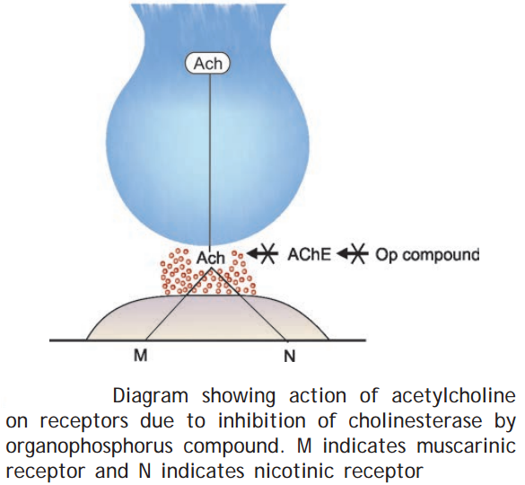

Slide 22
Organophosphate insecticide poisoning in human can produce
1-Acute toxicity.
2-An intermediate syndrome with weakness.
3-Organophosphate-Induced Delayed Polyneuropathy (OPIDP).
4- Chronic toxicity.

Slide 23
Clinical presentation of acute poisoning
Central nervous system.
Peripheral nervous system.
1- Muscarinic effects.
2-Nicotinic effects: stimulation of nicotinc receptors causes release of adrenaline and noradrenaline

Slide 24
Clinical Picture
CNS manifestations
Stimulant effects: anxiety, restlessness, confusion, delirium, hallucination, tremors and rarely seizures.
Depressed effects: coma, depression of respiratory and circulatory centers.

Slide 25
Muscarinic manifestations
1-GIT: anorexia, nausea, vomiting, intestinal cramps, diarrhea.
2-Cardiovascular system: hypotension and bradycardia.
3-Respiratory system: Dyspnea, wheezes due to bronchospasm and pulmonary edema due to increased bronchial secretion (bronchorrhea). Pulmonary edema can lead to hypoxia and tachycardia.
4-Salivary, sweet and lacrimal glands: increased saliva, sweating and lacrimation.
4-Ocular signs: miosis and blurred vision, due to cholinergic effect on the papillary constrictors and ciliary body.

Slide 26
N.B.1 The muscarinic signs can be remembered by use of the following mnemonic SLUDGE(M)/BBB: Salivation, Sweating, Lacrimation, Urination, Diarrhea, Gastric upset Emesis, Miosis, Bronchorrhea, Bronchospasm, Bradycardia.

Slide 27
Nicotinic effects
1-Somatic motor stimulation: Muscle fasciculation, cramps and muscle weakness, followed by paralysis and areflexia due to excessive stimulation at neuromuscular junction.
2-Sympathetic stimulation: tachycardia and hypertension.

Slide 28
N.B.2:Stimulation of nicotinic receptors causes release of adrenaline and nor-adrenaline, producing symptoms best remembered with the mnemonic: MATCH 1- Muscle weakness and fasciculation. 2- Adrenal medulla activity increase. 3- Tachycardia. 4- Cramping of skeletal muscles. 5- Hypertension.

Slide 29
Mechanism of death
Death occurs secondary to respiratory arrest caused by:
1-CNS depression (CNS action).
2-Respiratory muscular weakness and paralysis (nicotinic action).
3-Excessive bronchial secretion and bronchospasm (muscarinic action).

Slide 30
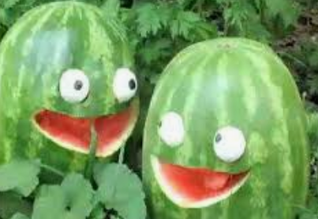
Diagnosis
i- History: patient may give history of
working with agricultural chemicals in a closed space, exposing the skin to these chemicals or ingesting a compound suspected or known to be insecticide.
Epidemics occur with contaminated food products or terrorist activity.

Slide 31
ii-Clinical picture and proper physical examination.
Miosis and muscle fasciculations are frequent and reliable indicators of OPs toxicity. Also, garlic-like odor may be noted on breath.
Typically, the patient presents anxious and diaphoretic, with excessive salivation, miosis and tachycardia.
Copious vomiting and diarrhea often occur.

Slide 32
Note The Following 1- clinical presentation may vary, depending on: a- The specific agent. b- Exposure route. c- Amount. 2- Depressed respirations, bradycardia, and hypotension are possible symptoms. Alternatively, hypertension, and tachycardia also are possible.

Slide 33
iii- Diagnostic tests.
1-ECG: may reveal sinus tachycardia initially due to sympathetic stimulation. Then, parasympathetic tone predominates causing sinus bradycardia, atrioventricular block, complete heart block and asystole.
2-Chest radiograph: may show pulmonary edema in severe cases and hyperlucency consistent with bronchospasm

Slide 34
3- Chemistry
A- Electrolytes: hypokalemia and hyperglycemia.
B- CBC: leukocytosis.
C- Urine analysis: proteinuria and glycosuria may occur.

Slide 35
4-Toxin-specific test (cholinesterase assays): are helpful for diagnosis
Plasma and RBC cholinesterase levels are depressed in OPs poisoning.
Depression of the RBC cholinesterase level is more specific and parallels the activity of cholinesterase.
Plasma cholinesterase levels are less specific but are readily available in many hospitals.

Slide 36
As a rough guide 20% - 50% of the normal value is found with mild OPs poisoning. 10% - 20% of the normal value with moderate OPs poisoning. Less than 10% of the normal value in cases of severe OPs poisoning.

Slide 37
Treatment
1-Emergency stabilization of the ABCs.
2- Decontamination.
3-Antidotal therapy: concomitant atropine and oxime
4- Symptomatic treatment.
5- Disposition and follow up.

Slide 38
1- Emergency stabilization of the ABCs:
Airway management with frequent suction of secretion and respiratory support.
Intubation may be required to facilitate control of secretion.
The patient is placed on 100% oxygen for 1 to 2 hours then 70% and a cardiac monitor.
An intravenous line is established
Baseline blood sampling and determination of cholinesterase levels should be done.

Slide 39
2- Decontamination: It is carried out according to the route of exposure
GIT decontamination:
Ipecac shouldn't be used.
Gastric lavage with a large bore orogastric tube with care taken to prevent aspiration as many OPs compounds are in petroleum distillate vehicles which, if aspirated, may precipitate pneumonitis.
Activated charcoal is administered unless contraindicated.

Slide 40
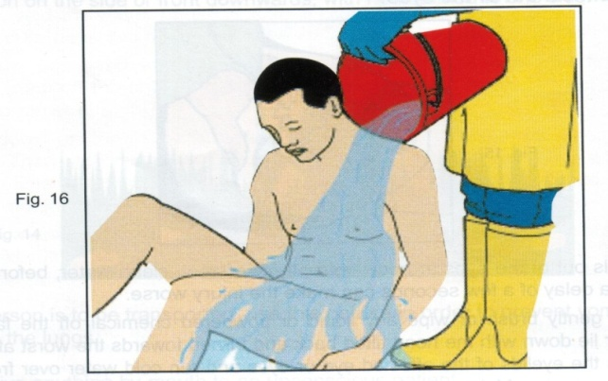
Dermal decontamination:
Removal of clothes by hospital personnel wearing rubber gloves and masks.
Wash the skin with soap and water.
Contaminated clothes should be destroyed.
Remove the patients from the polluted atmosphere if exposure is by inhalation.

Slide 41
3-Antidotal therapy: concomitant atropine and oximes
Atropine: is a competitive antagonist of acetylcholine at muscarinic sites, it is a tertiary amine that crosses the BBB. Thus, atropine treats the muscarinic effects and possibly the CNS toxicity of OPs.
Dose for adults: 2 to 4 mg, intravenously.
Dose for children: 0.05 mg/kg.
If no effect is noted, the dose is doubled every 5 to 10 minutes until dryness of trachea-bronchial secretions.
Pupillary dilatation is not a therapeutic end point.

Slide 42
Target end-points for atropine therapy
Clear chest on auscultation with no wheeze.
Heart rate >80 beats/min.
Pupils no longer pinpoint.
Dry axilla.
Systolic blood pressure >80 mmHg.

Slide 43
Oximes: Pralidoxime (protopam, 2-PAM), Obidoxime (toxiguanine):
Pralidoxime is a quaternary amine oxime, which can regenerates acetylcholinesterase.
It works by attacking the phosphate moiety of the OPs-cholinesterase complex, forming an oxime-phosphate, which lifts off the enzyme, freeing it for normal activity.
Also detoxifies the remaining OPs. Thus, 2-PAM reverses nicotinic, muscarinic and CNS effects of OPs and OPs-related muscle paralysis. It should be given within 24 to 36 h of acute exposure before" aging" of enzyme.

Slide 44
Cont.,
Dose for adults: 1 g.
Dose for children: 20 to 40 mg/kg.
Oximes are given by intravenous infusion in normal saline over 30 minutes every 6 hours for 24 to 48 hours, or until signs and symptoms resolve.
Response usually occurs within 10 to 40 minutes of administration of concomitant antidotal therapy.

Slide 45
4- Symptomatic treatment
Seizures: can be controlled by diazepam.
Hypotension: normal saline.
Pulmonary edema and bronchospasm: Oxygen, intubation, positive pressure ventilation.

Slide 46
Disposition and follow up
Mild toxicity requires only decontamination and observation for 6 to 8 hours but all significant toxicity requires admission to the intensive care.
Patients, who ingest OPs intentionally, should undergo psychiatric evaluation and counseling.
Workers shouldn't be reexposed to OPs until acetylcholinesterase levels are more than 75%.

Slide 47
Intermediate Syndrome (IMS)
It may occur between 24 and 96 hours after ingestion following resolution of the cholinergic crisis and is characterized by:
1- Weakness of the upper extremities and neck flexors.
2- Cranial nerve palsies.
3- Secondary respiratory arrest.

Slide 48
Cont., (IMS)
The syndrome is important as apparently well patients can suddenly develop respiratory arrest; Therefore, an evaluation must occur in all poisoned patients.
The first sign is often weakness of neck flexion such that patients cannot lift their heads off the bed.

Slide 49
Cont., (IMS)
The exact pathophysiology of the syndrome is unknown.
It may be attributed to inadequate oxime dosing or redistribution from lipid stores.
Respiratory failure resulting from weakness affecting the diaphragm and intercostal muscles.

Slide 50
Organophosphate- Induced Delayed Polyneuropathy (OPIDP)
It may occur 1–5 weeks after severe exposure.
The symptoms occur distally and progress proximally.
It is a neuropathy caused by damaging the afferent fibers (axonal damage) of peripheral and central nerves, as a result of acute or chronic OP poisoning.

Slide 51
Cont., (OPIDP)
This neuropathy is not related to ACHE inhibition. The target is a neuropathy esterae present in the nerve tissue which can be inhibited by several OPs.
The symptoms occur distally and progress proximally. The neuropathy is usually mixed with the patients complaining paraesthesias and motor weakness.

Slide 52
Cont., (OPIDP)
Tingling of the hands and feet followed by sensory loss.
Progressive muscle weakness.
Flaccidity of the distal skeletal muscles of the extremities.
Ataxia.
This is called distal sensorimotor axonopathy.
Recovery may occur gradually.

Slide 53
Chronic toxicity of OPs
Chronic exposure is common in workers who come in contact with small amounts of toxin.
Cholinesterase inhibition becomes sufficient to produce manifestations identical to acute poisoning.

Slide 54
Long term toxicity
Exposure to lower doses of OPs which could not be produce cholinergic signs, may lead to long-term adverse effects, particularly in the central and peripheral nervous systems.

Slide 55
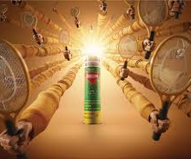
Carbamates

Slide 56
*Carbamate insecticides are derivatives of carbamic acid.
*They are widely used in homes, gardens and agriculture. e.g. Aldicarb (temik), carbaryl (sevin), propoxur (baygon) and methomyl (Lannate).

Slide 57
Mechanism of action:
Like organophosphate, but carbamates reversibly inhibit acetylcholinesterase and plasma pseudocholinesterase. They hydrolyze spontaneously from the enzymatic site within 48 hours. They cause increased activity of acetylcholine at the nicotinic and muscarinic receptors. Carbamates poorly pass BBB & thus have less CNS effects.

Slide 58
The clinical presentation
Carbamates toxicity is typically as muscarinic and nicotinic manifestations of OPs (cholinergic crisis of OPs) but with less CNS toxicity without seizures and a short duration of action.
N.B. Chronic exposure to carbamate is unlikely to produce significant toxicity because carbamates is rapidly reversible acetylcholinesterase inhibitor.

Slide 59
Treatment
1-Emergency stabilization and decontamination measures are the same as OPs.
2-Antidotal therapy: Atropine is the antidote of choice.

Slide 60
Summary of carbamate versus organophosphate poisoning

Slide 61
Thank you

